Slide 1
Group 1: Intelligent Transportation System
Section 2

Slide 2
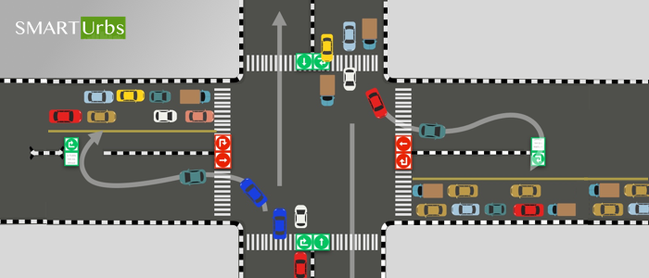
Reducing congestion at a 4-way intersection using probabilistic modelling

Slide 3
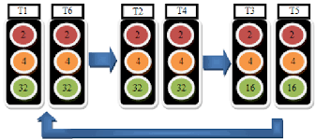
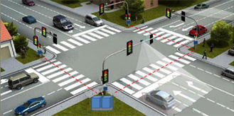
Objective and scope of the project
Our objective is to minimise the waiting time E[W] for the vehicles
Same Timing for green phase no matter Responds to real time congestion
the timing

Slide 4
System Overview
Observe traffic density / queue length at each approach
Use probabilistic models for:
arrivals (how many cars come)
clearance (how fast queues clear)
Compute weights from queue lengths
Pick next green using weighted randomization (higher congestion → higher chance)
Evaluate performance via simulation (waiting time, queue reduction)

Slide 5
Sources of Uncertainty
Arrival uncertainty: timing + number of vehicles approaching is random
Clearance uncertainty: time to clear depends on variation in vehicle speeds
Rate varies over time (peak vs off-peak) using 𝝀(t)
Sensor/counting noise can affect observed queue estimates

Slide 6
Key Random Variables
𝑋: number of arrivals in interval 𝑡 (random count)
𝜆(𝑡): time-dependent arrival rate (peak vs off-peak)
𝑉: vehicle speed (random) modeled with Normal distribution
𝐿: queue length per approach (observed/current state)
𝐺: green light time required

Slide 7
Probabilistic Models and Assumptions
Arrivals follow Poisson:
  𝑃(𝑋=𝑘)=((𝜆𝑡)^𝑘)*𝑒^(−𝜆𝑡)/𝑘!
Vehicle speed follows Normal:
  𝑉∼𝑁(𝜇,𝜎²)
𝜆(𝑡) changes with time (non-constant arrival rate)
Simplifying assumptions: memoryless arrivals + independent speeds

Slide 8
Probabilistic Reasoning/Decision Logic
Use current queues to estimate which direction “needs” green more
Relate green time to clearance:
  𝐸[𝐺]=𝐸[𝐿] ⁄ 𝐸[𝑉]
Idea: larger queue length → higher expected green needed
Use probability/weights instead of strict rules to avoid always serving the same lane

Slide 9
Implementation and Simulation
Implemented using Monte Carlo simulation in Python
Generate arrivals using numpy.random.possion
Generate speeds using numpy.random.normal
Weighted randomisation:
probability(lane gets green) ∝ lane density / total density
scribe (1)
Track outcomes: queue length trends + waiting time improvements

Slide 10
Limitations
Real traffic often arrives in platoons/bursts, so arrivals may be correlated
Poisson assumption may be weak during heavy upstream signal influence
Normal speed assumption may not capture extreme behaviors (very slow/very fast)
Fairness risk: low-density lanes might wait too long without constraints (needs guardrails)

Slide 11
Planned Refinements
Improve 𝜆(𝑡) to reflect burstiness/platoons better
Use Markov chains to model switching between congested and free-flow states
Analyze extreme congestion using bounds (e.g., Chernoff bounds)
Add fairness constraints (max-red time / minimum service probability)

Slide 12
Summary
Fixed-time signals are inefficient under random traffic conditions
We model:
arrivals with Poisson
clearance with Normal speeds
time variation with 𝜆(𝑡)
We use weighted randomization to decide green allocation
Next: improve realism (platoons), add fairness, and strengthen theoretical validation

